Slide 1
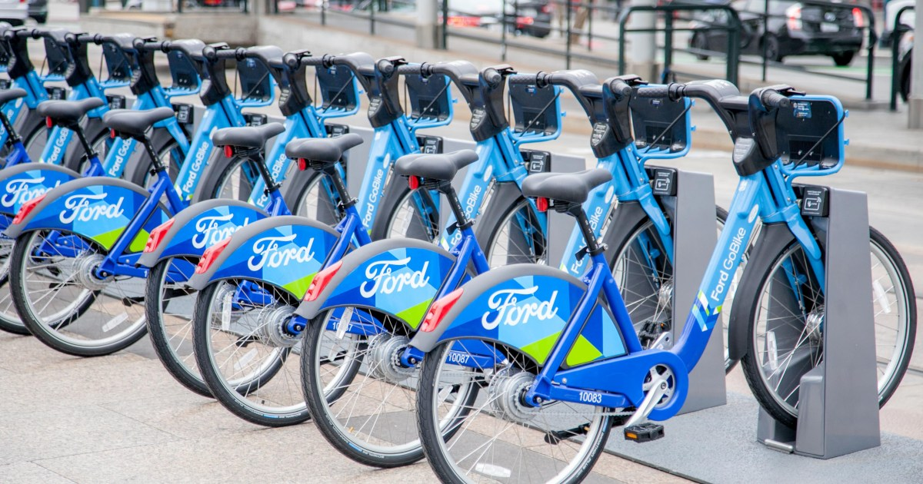
Ford Bike Sharing Project

Slide 2
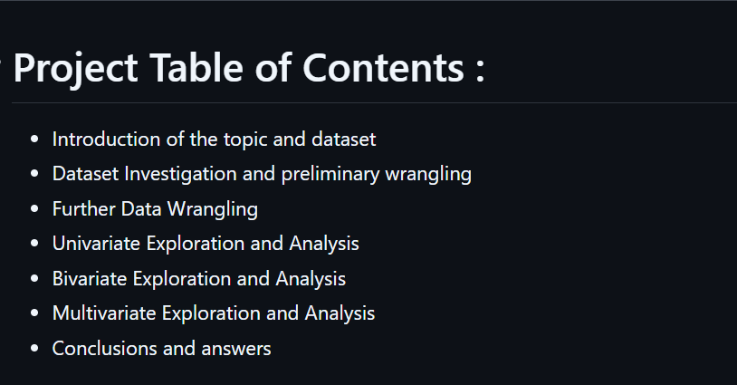

Slide 3


Slide 4

https://www.ford.com/

Slide 5
